Slide 1

Open Forum Discussion
October 24th, 2017

Slide 2
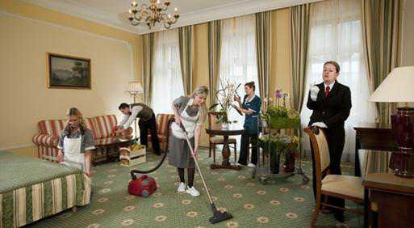
Housekeeping
Curtis’s talk tentatively rescheduled for February 2018
Looking for presenters in spring 2018
Hiring or looking for work?
Next meetup November 28th: Mayur Patel – Docker on Windows

Slide 3

Thanks to Sponsors
Are you interested in being a sponsor? Let use know.
Notes:
Postsharp, ReSharper, RebDeBug, Microsoft, Process Solutions, Cloudtrend, Infragistics, Pluralsight, Azure, Windows Phone, Xamarin, Ncover, Microsoft Press, Apress, O’Reilly

Slide 4


Topic 1: Life of Config File
Why use a config file instead of a database?
What do you store in a config file and why?
How to you update the config file as it changes environments (DEV, UAT, PROD, etc)?
Discuss environment specific config file settings.
Notes:
Bring up notes in text file.

Slide 5

Topic 2: PostSharp
Pattern-aware compiler extension for C# and VB.
https://www.postsharp.net/
Full disclosure: potential sponsor.
Notes:
Michael to do talk.

Slide 6

Topic 3: Tools for Apache Cordova (TACO)
Build apps for iOS, Android, and Windows using web technologies.
https://www.visualstudio.com/vs/cordova/
Notes:
Michael to lead.

Slide 7
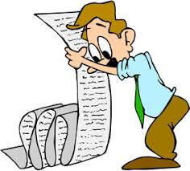
Any Other Topics?
Any other topics to discuss?
Notes:
Machine Learning, Xamarin, etc.

Slide 8
Wrap-up
Survey and prize draw, constructive feedback appreciated.
Next meetup November 28th: Mayur Patel – Docker on Windows
Contact: http://edmug.net https://github.com/edmug info@edmug.net
Notes:
Don’t forget to thank sponsors. Ask for presenters, etc.

